Slide 1
GOD’S LAWS OF HEALTH
NUTRITION
EXERCISE
WATER
SUNLIGHT
TEMPERANCE
AIR
REST
TRUST IN GOD
NEWSTART

Slide 2


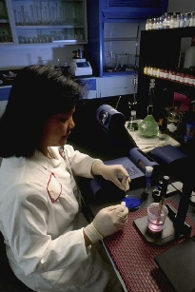

EXERCISE
Ex:20:9: Six days shalt thou labour, and do all thy work:
Ex:23:12: Six days thou shalt do thy work, ...
NEWSTART

Slide 3
EXERCISE
Proverb:6:6: Go to the ant, thou sluggard; consider her ways, and be wise:
Proverb:6:7: Which having no guide, overseer, or ruler,
Proverb:6:8: Provideth her meat in the summer, and gathereth her food in the harvest.
Proverb:6:9: How long wilt thou sleep, O sluggard? when wilt thou arise out of thy sleep?
Proverb:6:10: Yet a little sleep, a little slumber, a little folding of the hands to sleep:
Proverb:6:11: So shall thy poverty come as one that travelleth, and thy want as an armed man.

Slide 4
Joh:5:17: But Jesus answered them, My Father worketh hitherto, and I work.
M't:16:27: For the Son of man shall come in the glory of his Father with his angels; and then he shall reward every man according to his works.
Joh:14:12: Verily, verily, I say unto you, He that believeth on me, the works that I do shall he do also; and greater works than these shall he do; because I go unto my Father.
Joh:9:4: I must work the works of him that sent me, while it is day: the night cometh, when no man can work.

Slide 5
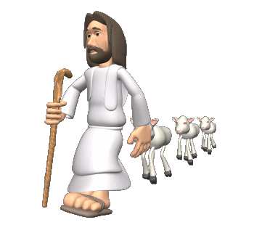
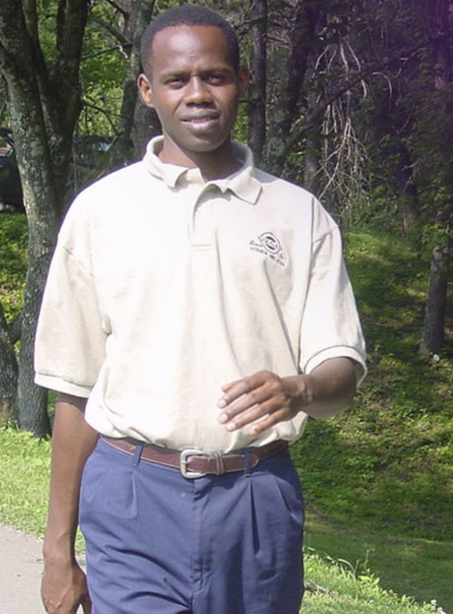
EXERCISE
Action is a law of our being. Every organ of the body has its appointed work, upon the performance of which its development and strength depend. The normal action of all the organs gives strength and vigor, while the tendency of disuse is toward decay and death.
NEWSTART

Slide 6
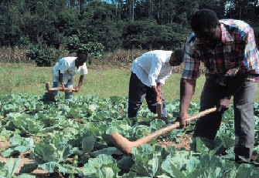
EXERCISE
Bind up an arm, even for a few weeks, then free it from its bands, and you will see that it is weaker than the one you have been using moderately during the same time. Inactivity produces the same effect upon the whole muscular system. MH Page 237-238
NEWSTART

Slide 7
HEALTH SONG

Slide 8

HEALTH SONG (refrain)
Health for you!
Health for me!
Health for all mankind!
Healing for the halt and lame,
And vision for the blind;
Health for you!
Health for me!
Health for all mankind!
This our goal:
Our body whole
In spirit, flesh, and mind.

Slide 9
HEALTH SONG
Sunshine and fresh air,
Clean and wholesome food,
Proper exercise,
Thoughts upright and good,
Keeps the cheeks aglow,
Bodies fit and strong,
Keep the brain alert and clean,
And give the heart a song!

Slide 10
HEALTH SONG (refrain)
Health for you!
Health for me!
Health for all mankind!
Healing for the halt and lame,
And vision for the blind;
Health for you!
Health for me!
Health for all mankind!
This our goal:
Our body whole
In spirit, flesh, and mind.

